Slide 1
Engineering Management
Project Management

Slide 2
Project management
Projects
Projects are unique, one-time operations designed to accomplish a set of objectives in a limited time frame.
Examples of projects include constructing a shopping complex, merging two companies, putting on a play, and designing and running a political campaign.
Examples of projects within business organizations include designing new products or services, designing advertising campaigns, designing information systems, reengineering a process, designing databases, software development, and designing web pages.
Build A
A Done
Build B
B Done
Build C
C Done
Build D
Ship
JAN
FEB
MAR
APR
MAY
JUN
On time!

Slide 3
PROJECT LIFE CYCLE
The size, length, and scope of projects vary widely according to the nature and purpose of the project.
Nevertheless, all projects have something in common:
They go through a life cycle, which typically consists of five phases.

Slide 4
PROJECT LIFE CYCLE
Initiating - This begins the process by outlining the expected costs, benefits, and risks associated with a project.
It includes defining the major project goals and choosing a project manager.
Planning - This phase provides details on deliverables, the scope of the project, the budget, schedule and milestones, performance objectives, resources needed, a quality plan, and a plan for handling risks.
The accompanying documents generated in the planning phase will be used in the executing and monitoring phases to guide activities and monitor progress. Members of the project team are chosen.

Slide 5
PROJECT LIFE CYCLE
Executing - In this phase, the actual work of the project is carried out.
The project is managed as activities are completed, resources are consumed, and milestones are reached.
Management involves what the Project Management Institute refers to as the nine management areas: project integration, scope, human resources, communications, time, risk, quality, cost, and procurement.

Slide 6
PROJECT LIFE CYCLE
Monitoring and Controlling - This phase occurs at the same time as project execution.
It involves comparing actual progress with planned progress and undertakes corrective action if needed, as well as monitoring any corrective action to make sure it achieves the desired effect.
Closing - This phase ends the project.
It involves handing off the project deliverables (assuming the project hasn’t been canceled), obtaining customer acceptance, documenting lessons learned and releasing resources.

Slide 7
Key Decisions in Project Management
Much of the success of projects depends on key managerial decisions over a sequence of steps:
❐ Deciding which projects to implement.
❐ Selecting the project manager.
❐ Selecting the project team.
❐ Planning and designing the project.
❐ Managing and controlling project resources.
❐ Deciding if and when a project should be terminated.

Slide 8
The Project Manager
The project manager bears the ultimate responsibility for the success or failure of the project.
He or she must be capable of working through others to accomplish the objectives of the project. The project manager is responsible for effectively managing each of the following:
1. The work, so that all of the necessary activities are accomplished in the desired sequence, and performance goals are met.
2. The human resources, so that those working on the project have direction and motivation.
3. Communications, so that everybody has the information needed to do the work.

Slide 9
The Project Manager
4. Quality, so that performance objectives are realized.
5. Time, so that the project is completed on schedule.
6. Costs, so that the project is completed within budget.
7. Scope, so the project stays within the prescribed scope, and “scope creep” doesn’t occur without commensurate changes to the schedule (if needed) and the budget.

Slide 10
Project management tools
Project Management Tools:
❐ Work Breakdown Structure
❐ Gantt Charts
❐ PERT and CPM

Slide 11
Project management tools
❐ Work Breakdown Structure
Work breakdown structure (WBS) A hierarchical listing of what must be done during a project.
This methodology establishes a logical framework for identifying the required activities for the project.
The first step in developing the work breakdown structure is to identify the major elements of the project. These are the Level 2 boxes.

Slide 12
Project management tools
❐ Work Breakdown Structure
The next step is to identify the major supporting activities for each of the major elements - the Level 3 boxes.
Then, each major supporting activity is broken down into a list of the activities that will be needed to accomplish it - the Level 4 boxes.
For purposes of illustration, only a portion of the Level 4 boxes are shown.)
Usually there are many activities in the Level 4 lists.
Large projects involve additional levels, but the figure gives you some idea of the concept of the work breakdown structure.

Slide 13
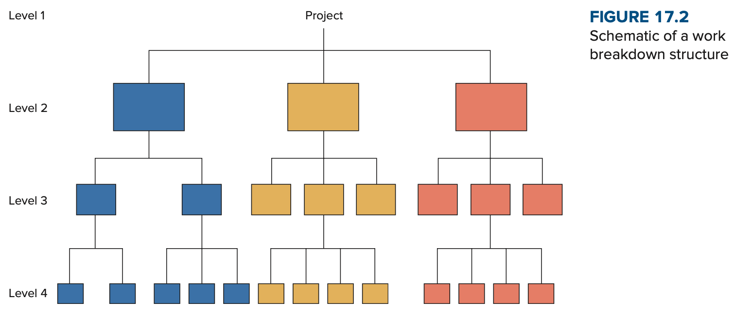
Project management tools
❐ Work Breakdown Structure

Slide 14
Project management tools
❐ Gantt Chart
The Gantt chart is a popular visual tool for planning and scheduling simple projects. It enables a manager to initially schedule project activities and then to monitor progress over time by comparing planned progress to actual progress.
The figure illustrates a Gantt chart for a bank’s plan to establish a new direct marketing department.
To prepare the chart, the vice president in charge of the project had to first identify the major activities that would be required.
Next, time estimates for each activity were made, and the sequence of activities was determined.

Slide 15
Project management tools
❐ Gantt Chart
Once completed, the chart indicated which activities were to occur, their planned duration, and when they were to occur.
Then, as the project progressed, the manager was able to see which activities were on schedule and which were behind schedule.

Slide 16
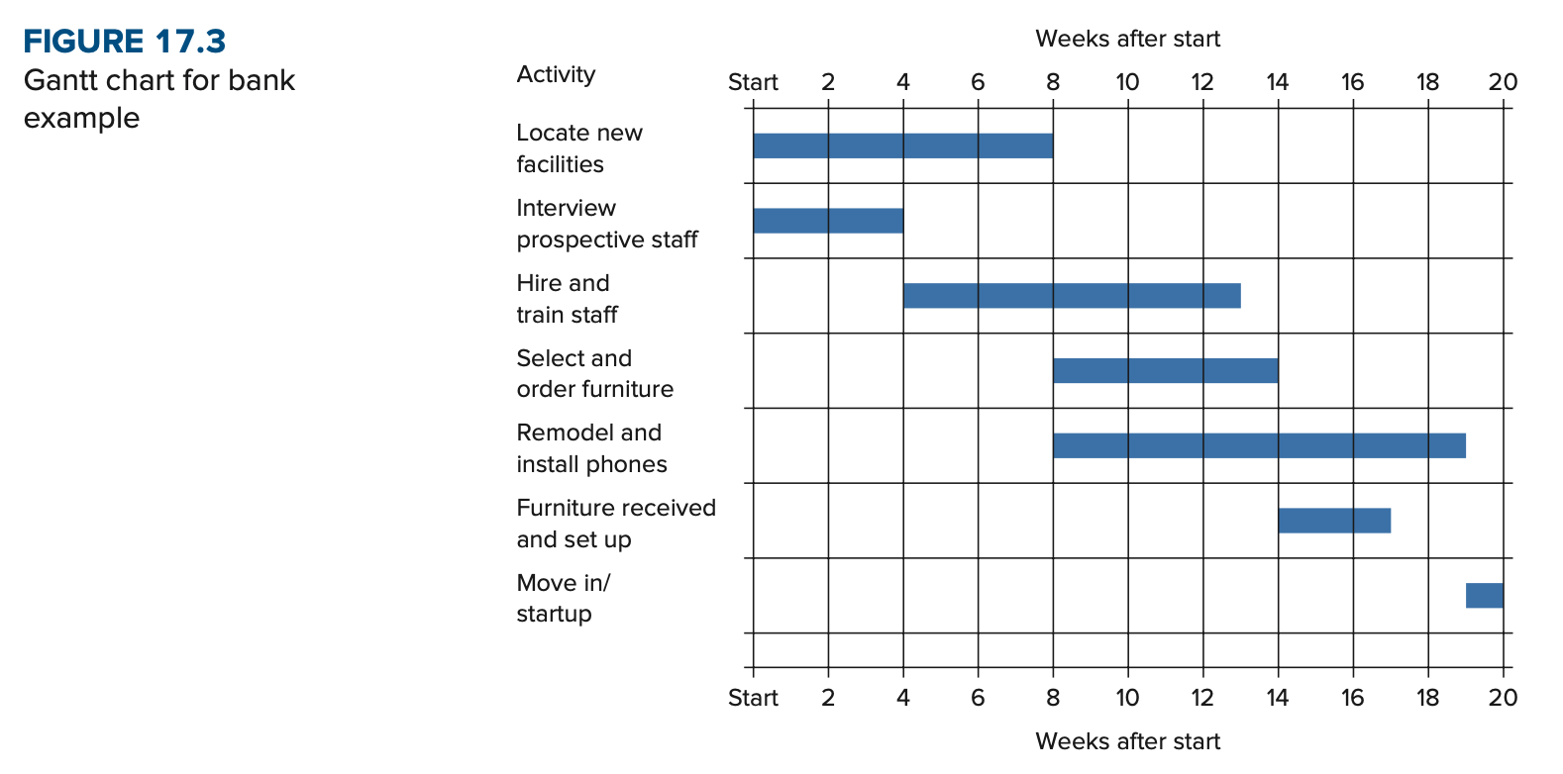
Project management tools
❐ Gantt Chart

Slide 17
Project management tools
❐ PERT and CPM
PERT (Program Evaluation and Review Technique) and CPM (Critical Path Method) are two of the most widely used techniques for planning and coordinating large-scale projects.
By using PERT or CPM, managers are able to obtain:
☞ A graphical display of project activities
☞ An estimate of how long the project will take
☞ An indication of which activities are the most critical to timely project completion
☞ An indication of how long any activity can be delayed without delaying the project

Slide 18
Project management tools
Critical Path Analysis
- Also called critical path method - is a network diagramming technique used to predict total project duration.
- A critical path is the series of activities that determine the earliest time by which the project can be completed.
- The longest path or the path containing the critical tasks is what is driving the completion date for the project.

Slide 19
Project management tools
Critical Path Analysis
The Network Diagram
One of the main features of PERT and related techniques is their use of a network (or precedence) diagram to depict major project activities and their sequential relationships.
There are two slightly different conventions for constructing these network diagrams.
Under one convention, the arrows designate activities; under the other convention, the nodes designate activities.

Slide 20
Project management tools
Critical Path Analysis
The Network Diagram
These conventions are referred to as:
Activity-on-Arrow (AOA) and Activity-on-Node (AON)

Slide 21
Project management tools
Critical Path Analysis
The Network Diagram
Activity
A specific task or set of tasks that are required by the project, use up resources, and take time to complete.
Event
The result of completing one or more activities. An identifiable end state that occurs at a particular time. Events use no resources.

Slide 22
Project management tools
Critical Path Analysis
The Network Diagram
Network
The arrangement of all activities (and, in some cases, events) in a project arrayed in their logical sequence and represented by arcs and nodes.
This arrangement (network) defines the project and the activity precedence relationships.
Networks are usually drawn starting on the left and proceeding to the right.
Arrowheads placed on the arcs are used to indicate the direction of flow - that is, to show the proper precedences.

Slide 23
Project management tools
Critical Path Analysis
The Network Diagram
Network (Contd.)
Before an event can be realized—that is, achieved—all activities that immediately precede it must be completed.
These are called its predecessors.
Thus, an event represents an instant in time when each and every predecessor activity has been finished.

Slide 24
Project management tools
Critical Path Analysis
The Network Diagram
Path
The series of connected activities (or intermediate events) between any two events in a network.
Critical Activities, events, or paths that, if delayed, will delay the completion of the project.
A project’s critical path is understood to mean that sequence of critical activities (and critical events) that connects the project’s start event to its finish event and which cannot be delayed without delaying the project.

Slide 25
Project management tools
Critical Path Analysis
The Network Diagram
To transform a project plan into a network, one must know what activities comprise the project and, for each activity, what its predecessors (or successors) are.
An activity can be in any of these conditions:
it may have a successor(s) but no predecessor(s);
it may have a predecessor(s) but no successor(s); and
it may have both predecessor(s) and successor(s).

Slide 26
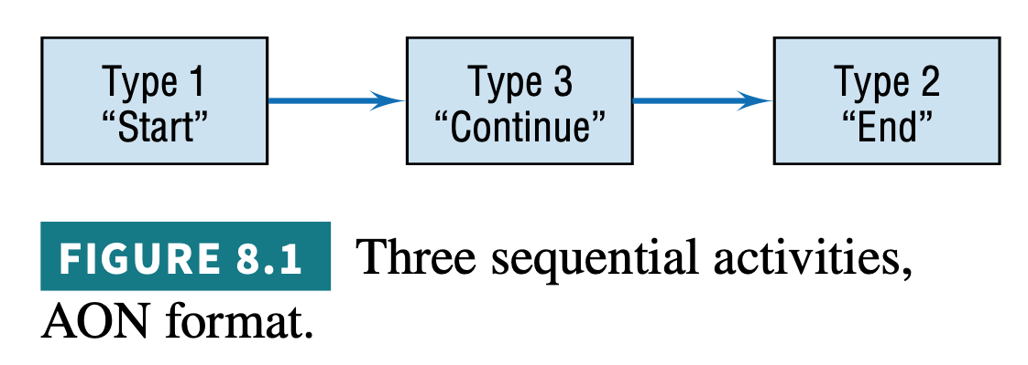
Project management tools
Critical Path Analysis
The Network Diagram
The first of these is an activity that starts a network.
The second ends a network.
The third is in the middle.
Figure 8.1 shows each of the three types of activities.

Slide 27
Project management tools
Critical Path Analysis
The Network Diagram
Activities are represented here by rectangles (one form of what in a network are called “nodes”) with arrows to show the precedence relationships.
When there are multiple activities with no predecessors, it is usual to show them all emanating from a single node called “START”, as in Figure 8.2.
Similarly, when multiple activities have no successors, it is usual to show them connected to a node called “END”.

Slide 28
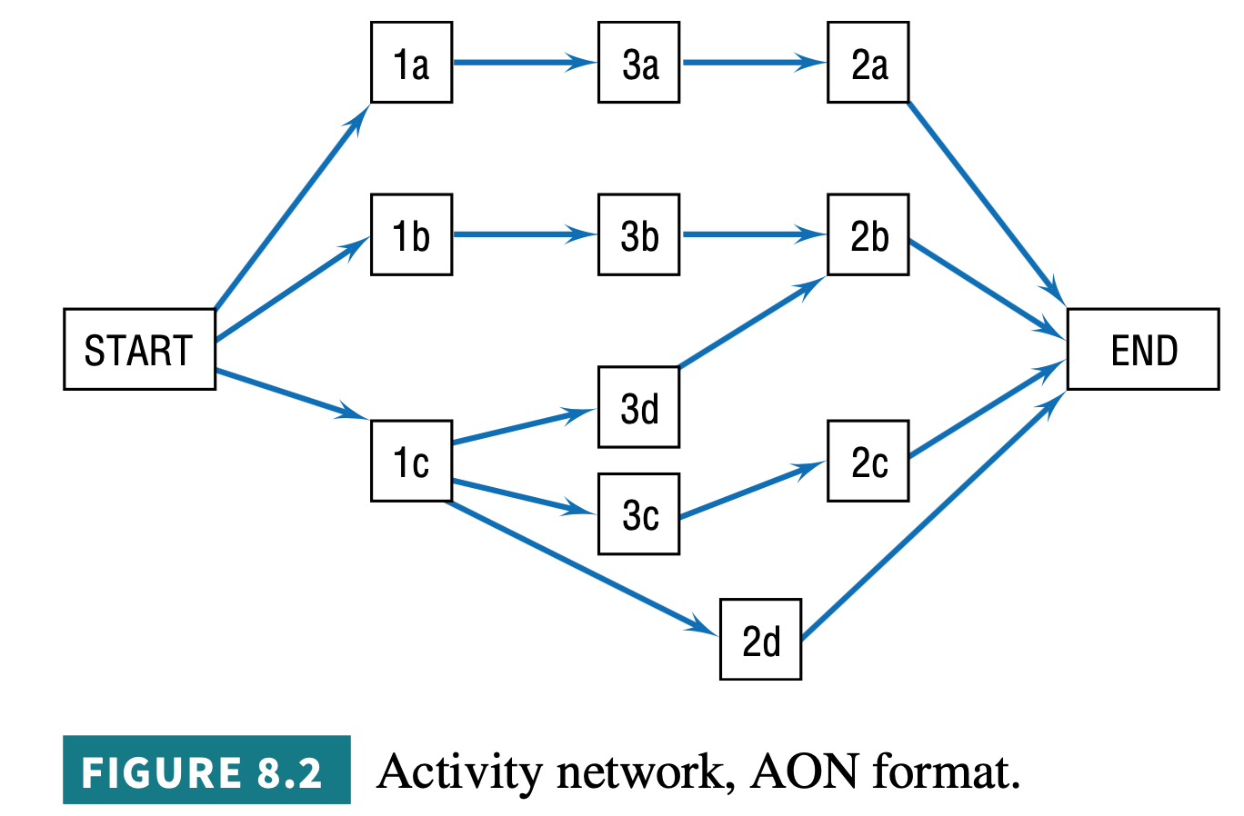
Project management tools
Critical Path Analysis
The Network Diagram

Slide 29
Project management tools
Critical Path Analysis
The Network Diagram
In the preceding examples, rectangles (nodes) represented the activities; hence, it was called an activity-on-node (AON) network.
Another format for drawing networks is activity-on-arrow (AOA), as shown in Figure 8.3.
Here, the activities are shown on the arrows, and the (circular) nodes represent events.
If the project begins with multiple activities, they can all be drawn emanating from the initial node, and multiple activities can terminate in a single node at the end of the project.

Slide 30
Project management tools
Critical Path Analysis
The Network Diagram
In the preceding examples, rectangles (nodes) represented the activities; hence, it was called an activity-on-node (AON) network.
Another format for drawing networks is activity-on-arrow (AOA), as shown in Figure 8.3.
Here, the activities are shown on the arrows, and the (circular) nodes represent events.
If the project begins with multiple activities, they can all be drawn emanating from the initial node, and multiple activities can terminate in a single node at the end of the project.

Slide 31
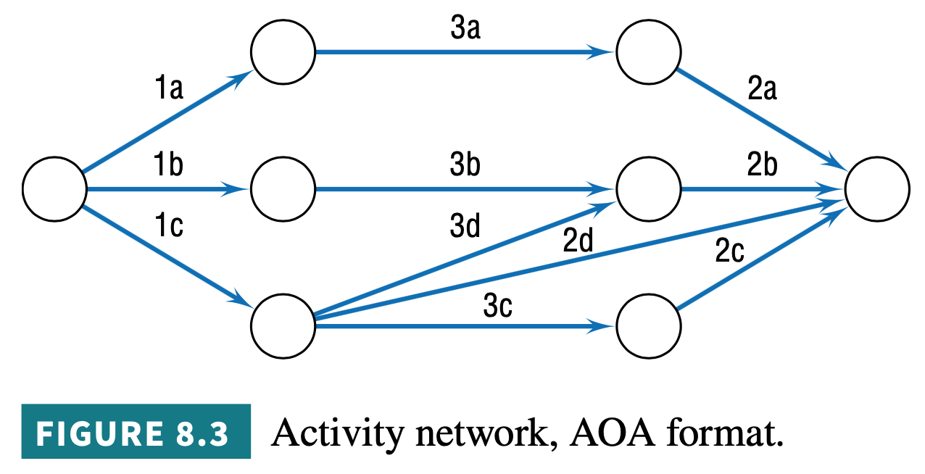
Project management tools
Critical Path Analysis
The Network Diagram

Slide 32
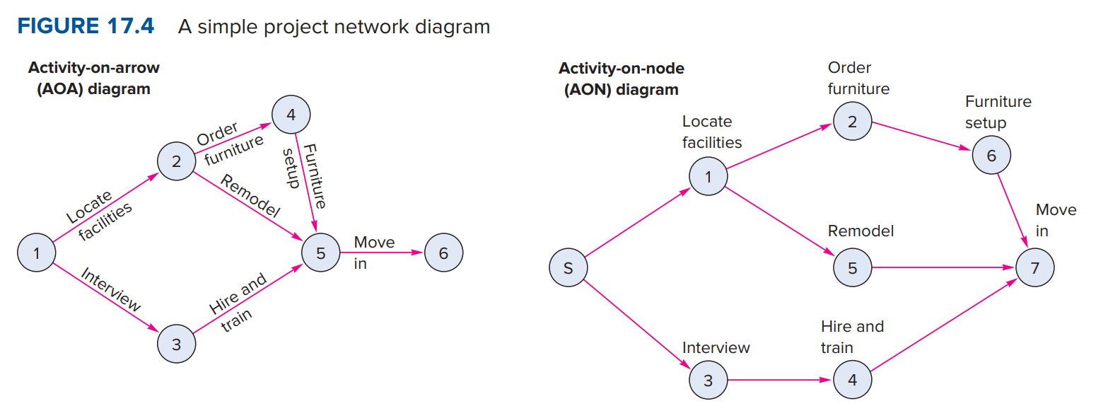
Project management tools
Critical Path Analysis
The Network Diagram

Slide 33
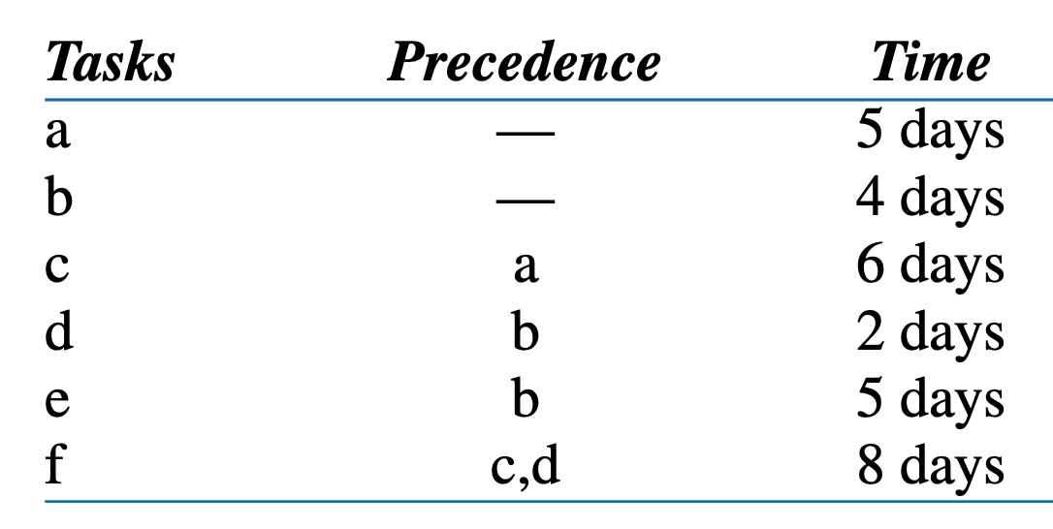
Project management tools
Critical Path Analysis
The Network Diagram

Slide 34
Project management tools
Critical Path Analysis
The Network Diagram

Slide 35
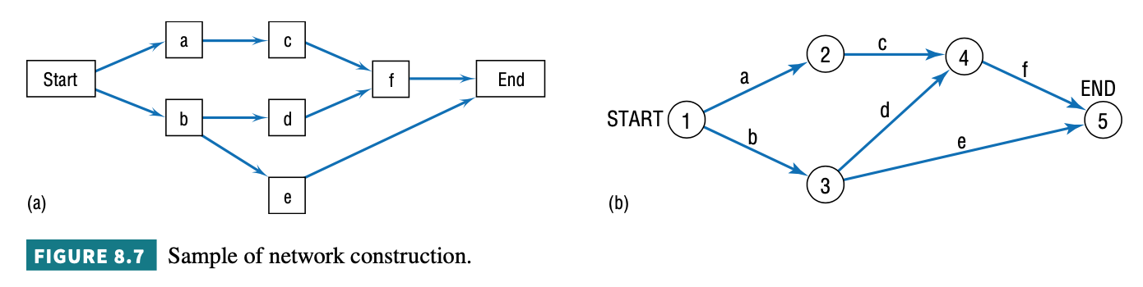
Project management tools
Critical Path Analysis
The Network Diagram

Slide 36
Project management tools
Critical Path Analysis
The Network Diagram
Paths that are shorter than the critical path can experience some delays and still not affect the overall project completion time as long as the ultimate path time does not exceed the length of the critical path.
The allowable slippage for any path is called slack, and it reflects the difference between the length of a given path and the length of the critical path.
The critical path, then, has zero slack time.

Slide 37
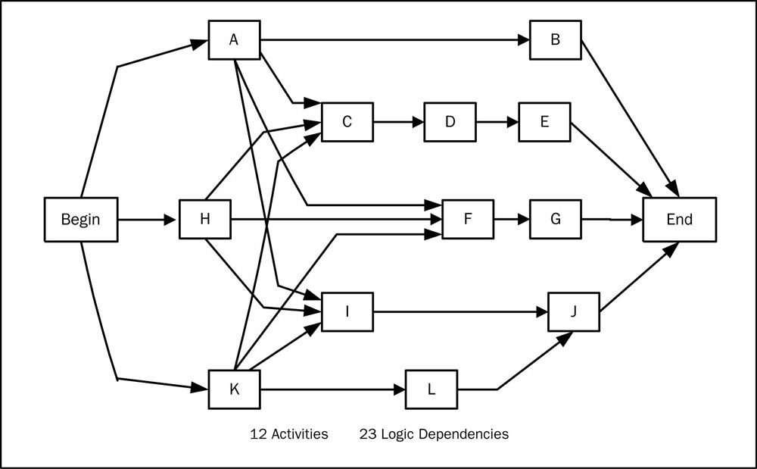
Project management tools
Critical Path Analysis

Slide 38
Project management tools
❐ Draw Precedence diagram and find critical path and expected project duration

Slide 39
Project management tools
ACITIVITY | Duration | Immediate Predecessor
A | 1 Day | n/a
B | 2 Days | n/a
C | 3 Days | n/a
D | 4 Days | A
E | 5 Days | B
F | 4 Days | B
G | 6 Days | C
H | 6 Days | D, E
I | 2 Days | G
J | 3 Days | H, F, I

Slide 40
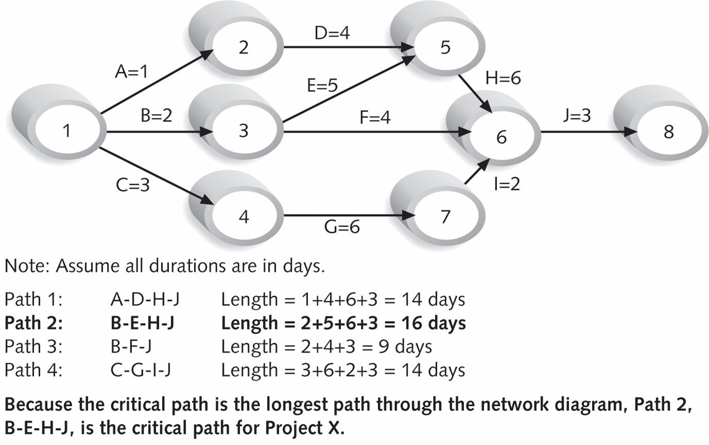
Project management tools
Critical Path Analysis
Path 1 : A – D – H - J
Path 2 : B – E – H - J
Path 3 : B – F – J
Path 4 : C – G – I - J

Slide 41
Project management tools
Critical Path Analysis
Path 1 : A – D – H - J
Length 1 : 1+4+6+3 = 14 days
Path 2 : B – E – H - J
Length 2 : 2+5+6+3 = 16 days
Path 3 : B – F – J
Length 3 : 2+4+3 = 9 days
Path 4 : C – G – I - J
Length 4 : 3+6+2+3 = 14 days

Slide 42
Project management tools
Critical Path Analysis

Slide 43
Project management tools
Critical Path Analysis
Identifying the Critical Path; Computing Project Duration and Slack Times for Deterministic Times Given the additional information on the bank network of Figure 17.4 shown in Figure 17.5, determine the following.
The length of each path
The critical path
The expected length of the project
The amount of slack time for each path

Slide 44
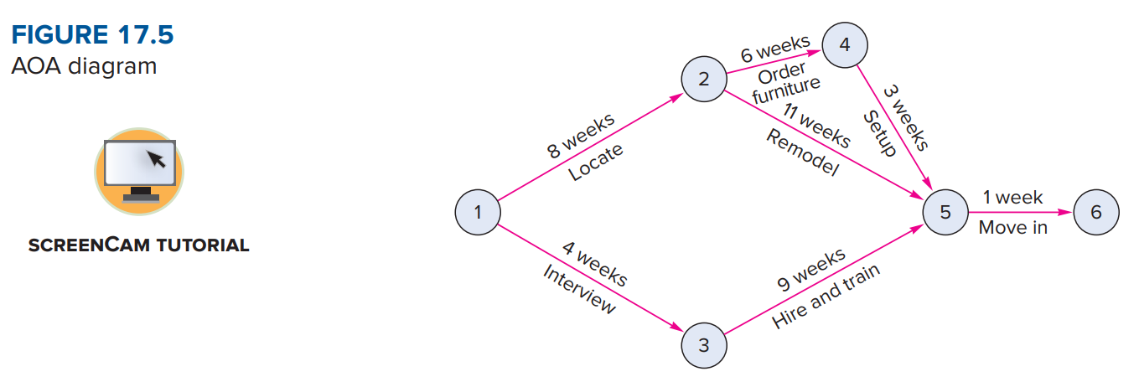
Project management tools
Critical Path Analysis

Slide 45
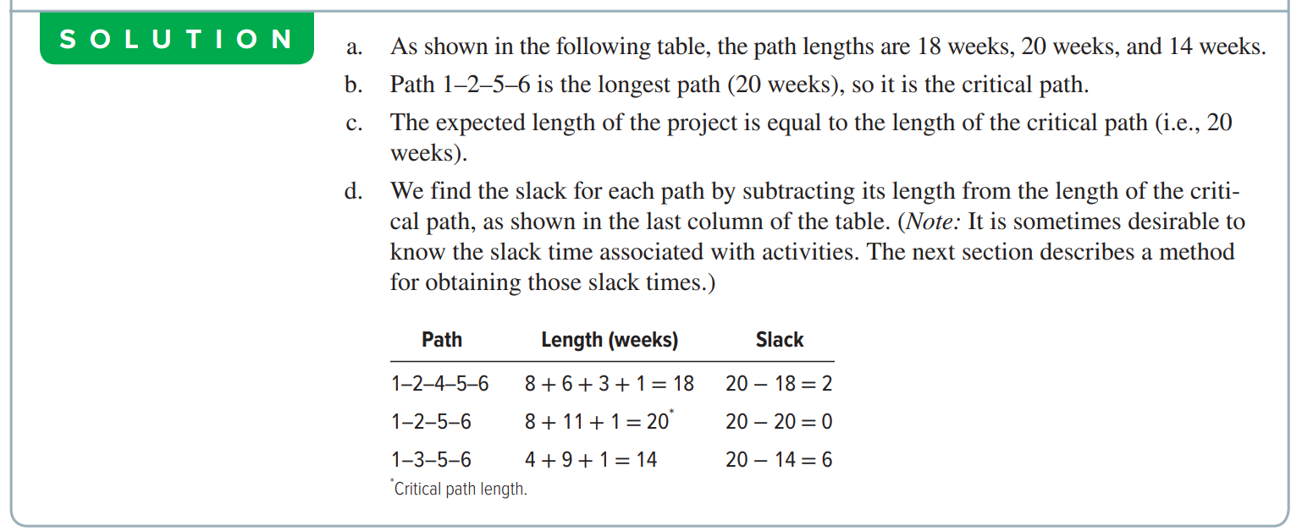
Project management tools
Critical Path Analysis

Slide 46
Project management tools
Critical Path Analysis
ES
EF
ES
EF
Activity Name
Duration
Activity Name
Duration
LS
LF
LS
LF
Notes :
ES : Earliest Start
EF : Earliest Finish
Notes :
LS : Latest Start
LF : Latest Finish

Slide 47
Project management tools
Critical Path Analysis
Forward Calculation
4
9
?
?
D, 5
E, 3
31
36
10
12
G, 2
34
36

Slide 48
Project management tools
Critical Path Analysis
Forward Calculation
4
9
12
15
D, 5
E, 3
31
36
10
12
G, 2
Have to take the Higher EF for the Immediate Successor (E)
34
36

Slide 49
Project management tools
Critical Path Analysis
Backward Calculation
10
26
26
30
H, 16
I, 4
?
?
36
40
26
34
J, 8
26
34

Slide 50
Project management tools
Critical Path Analysis
Backward Calculation
10
26
26
30
H, 16
I, 4
10
26
36
40
26
34
Have to take the Lowest LS for the Immediate Predecessor (H)
J, 8
26
34

Slide 51
Project management tools
Critical Path Analysis
Sample Problem #1
Activity | Immediate Predecessor(s) | Duration (Weeks) |  | Activity | Immediate Predecessor(s) | Duration (Weeks)
N |  | 5 |  | G | B | 2
A | N | 4 |  | H | B | 16
B | N | 10 |  | I | H | 4
C | N | 7 |  | J | H | 8
D | A | 5 |  | K | I, J, L | 5
E | D, G | 3 |  | L | C | 9
F | E | 6 |  | M | J, L | 10

Slide 52
Project management tools
Critical Path Analysis
Sample Problem #1
a) Draw the network diagram and find the critical path and project completion time.
b) Calculate float/ slack of the all activities.
c) Can activity I be delayed without delaying the project completion time? If so, how many weeks? How much dollar can be saved by keeping the project completion time unchanged, if $2500 can be saved for each delayed week of activity I?
d) What is the impact on the project if activity F needs a delayed time 2 weeks and extra time 5 weeks?
e) The PM wants to delay the duration of the activity M from 10 weeks to 16 weeks. What is the impact on the project completion time?

Slide 53
Project management tools
Critical Path Analysis
EF = ES + Duration (Forward)
LS = LF – Duration (Backward)
Sample Problem #1
5
9
9
14
A,4
D,5
17
20
20
26
35
40
E,3
F,6
31
35
15
17
G,2
40
43
43
49
0
0
5
5
15
31
35
49
49
0
38
40
I,4
39
44
Start
N,5
B,10
K,5
End
15
31
40
44
0
0
0
5
5
15
H,16
31
39
49
44
49
49
J,8
15
31
31
39
5
12
Module (Applied when path crossed)
12
21
39
49
C,7
L,9
M,10
23
30
30
39
39
49

Slide 54
Project management tools
Critical Path Analysis
Sample Problem #1
Project Completion Time = 49 weeks
Slack = LS – ES ||| LF - EF
Slack _{A} = 31- 5 = 26
Slack _{B} = 5 - 5 = 0
Slack _{C} = 23-5 = 18
Slack _{D} = 35-9 = 26
Slack _{E} = 40-17 = 23
Slack _{F} = 43-20 = 23
Slack _{G} = 38-15 = 23
Slack _{H} = 15 – 15 = 0
Slack _{I} = 40 – 31 = 9
Slack _{J} = 31 – 31 = 0
Slack _{K} = 44 – 39 = 5
Slack _{L} = 30 – 12 = 18
Slack _{M} = 39 – 39 = 0
Slack _{N} = 0 – 0 = 0

Slide 55
Project management tools
Critical Path Analysis
Sample Problem # 1
Project Completion Time = 49 weeks
Path 1 = N – A – D – E – F = 23 weeks
Path 2 = N – B – G – E – F = 26 weeks
Path 3 = N – B – H – I – K = 40 weeks
Path 4 = N – B – H – J – K = 44 weeks
Path 5 = N – B – H – J – M = 49 weeks
Path 6 = N – C – L – K = 26 weeks
Path 7 = N – C – L – M = 31 weeks
Critical Path = Path 5 = N+B+H+J+M = 49 weeks
Critical Activities = B, H, J, M, and N (Where the Slack is 0)
Non-Critical Activities = A, C, D, E, F, G, I, K, and L

Slide 56
Project management tools
Critical Path Analysis
Sample Problem #1
c) Can activity I be delayed without delaying the project completion time?
If so, how many weeks?
How much dollar can be saved by keeping the project completion time unchanged, if $2500 can be saved for each delayed week of activity I?
Yes, the Activity “I” can be delayed as it is a non-critical activity. It can be delayed upto the value of slack that is for 9 weeks.
Activity I has a slack of 9 weeks, so, $2500*9= $22,500/- can be saved by keeping the project completion time unchanged.

Slide 57
Project management tools
Critical Path Analysis
Sample Problem #1
d) What is the impact on the project if activity F needs a delayed time 2 weeks and extra time 5 weeks?
According to the question, activity F needs to delay by 2+5= 7 weeks, it is possible by keeping the project completion time unchanged as F is a non-critical activity with a slack of 23 weeks.

Slide 58
Project management tools
Critical Path Analysis
Sample Problem #1
e) The PM wants to delay the duration of the activity M from 10 weeks to 16 weeks. What is the impact on the project completion time?
According to the question, if the Project Manager wants to delay the
duration of the activity M from 10 weeks to 16 weeks, then it will delay the entire duration of the project.
As activity M, falls under critical activity of the project, therefore the Slack of activity M is 0.
It will eventually increase the project duration to more 6 days (a total of 49+6 = 55 days) to complete the project in this situation.

Slide 59
Project management tools
Critical Path Analysis
Sample Problem # 2
Activity | Immediate Predecessor(s) | Duration (Weeks) |  | Activity | Immediate Predecessor(s) | Duration (Weeks)
A |  | 4 |  | F | B | 6
B |  | 10 |  | G | C | 2
C |  | 7 |  | H | F | 8
D | A | 5 |  | I | F, G | 11
E | B | 3 |  | J | D, E | 8

Slide 60
Project management tools
Critical Path Analysis
Sample Problem # 2
Draw a network diagram and find the critical path and project completion time.
Calculate float/ slack of the all activities.
If $1000 can be saved for each delayed day of activity H, then how much dollar can be saved keeping the project completion time unchanged?
Activity G needs a delayed time of two weeks and an extra time of five weeks. Is it possible by keeping the project completion time unchanged? Explain.
The PM wants to shorten the duration of the activity I from 11 weeks to 9 weeks. What is the impact of this change on project completion time

Slide 61
END OF THE CHAPTER

